Slide 1
Preparing for Influenza Season
Objective
To help a medical staffing agency that provides temporary workers to clinics and hospitals on as-needed basis. The analysis will help plan for influenza season, a time when additional staff are in high demand. Project brief can be found here.
Data Set
Influenza deaths by geography, time, age, and gender by CDC.
Population data by geography by US Census Bureau.
Note: The numbers are estimates. The sum of the numbers from the different age groups may not sum up to the total in the first columns.
Tools and Procedures
MS Excel
Storytelling in Tableau
Data cleaning
Data integration
Data transformation
Statistical hypothesis testing
Visual analysis
Forecasting

Slide 2
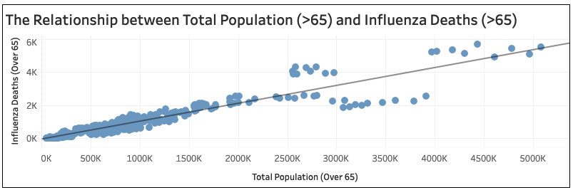
Assumption
“Vulnerable populations suffer the most-severe impacts from the flu and are the most likely to end up in the hospital.”
Research Hypothesis
If a state has a large population of individuals over the age of 65, then it is more likely there will be a high number of influenza deaths for individuals over the age of 65 in that state.
One-tailed test shows a p-value of 6.25E-157.
The scatterplot below shows a strong correlation between total population over 65 years and influenza deaths over 65 years.
As the population of people over 65 years continues to increase, so does the number of influenza deaths.
Description | U.S. Census (over 65 years) | Influenza Deaths (over 65 years)
Standard Deviation | 886050 | 1014
Mean | 806989 | 826
Outlier Percentage | 8.28% | 4.58%
Correlation Coefficient | 0.94265

Slide 3
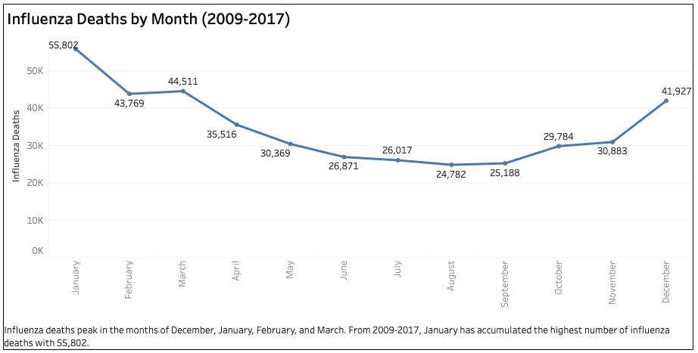
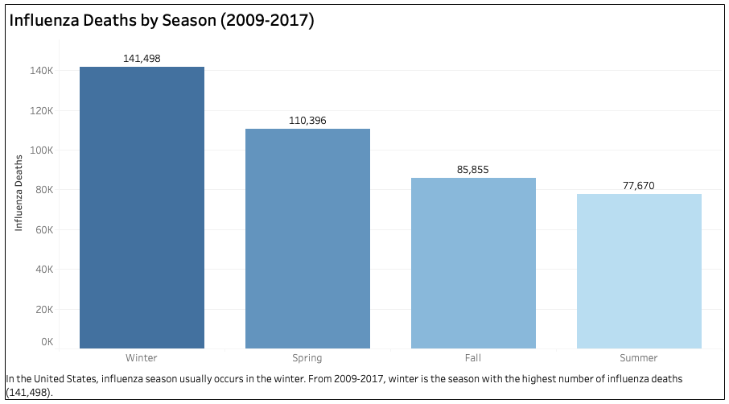
When is Influenza Season?
Based on the column chart, flu season usually occurs in the winter.
From 2009-2017, winter was the season with the highest number of deaths; amounting to 141,498.
This total amount can be further explained by looking at the line chart, which breaks down influenza deaths by month.
Influenza deaths peaked in the months of December, January, and February, which are considered “winter” months, although significant activity can last as late as March.
January accumulated the highest number of influenza deaths with 55,802, followed by February with 43,769 and December with 41,927.

Slide 4
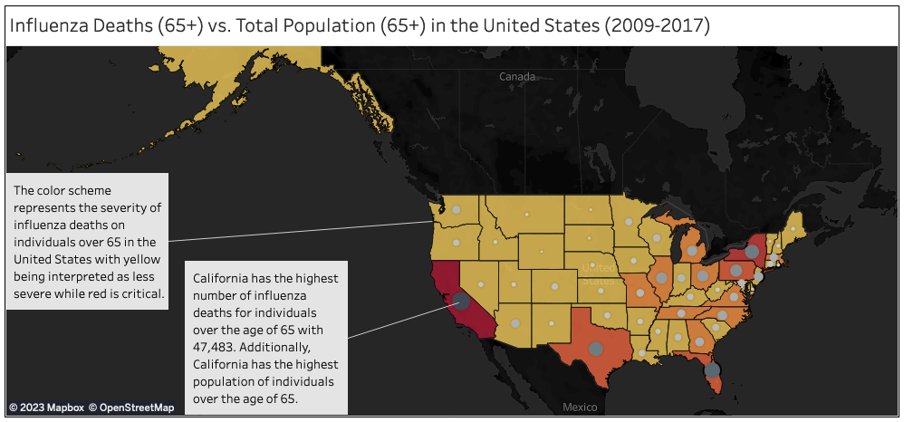

ANALYSIS
California, New York, Texas, Pennsylvania, and Florida are among the top 5 states with high influenza death counts of individuals over the age of 65 years.
The large gray circle that lies on top of California means that California possesses the highest number of influenza deaths for individuals over 65 with 47,483.
Along with the highest population of individuals over the age of 65 with 40,346,770.

Slide 5



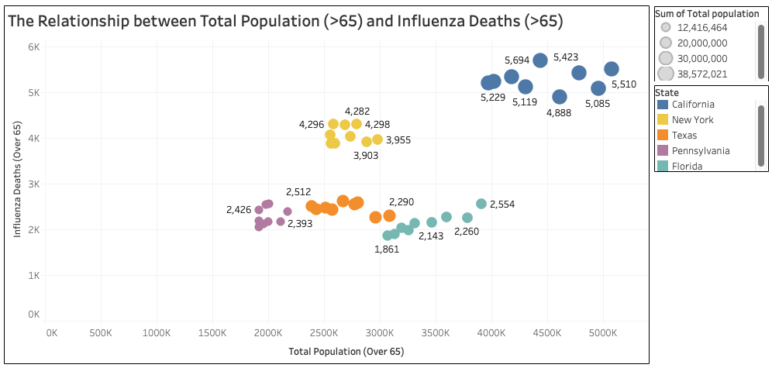
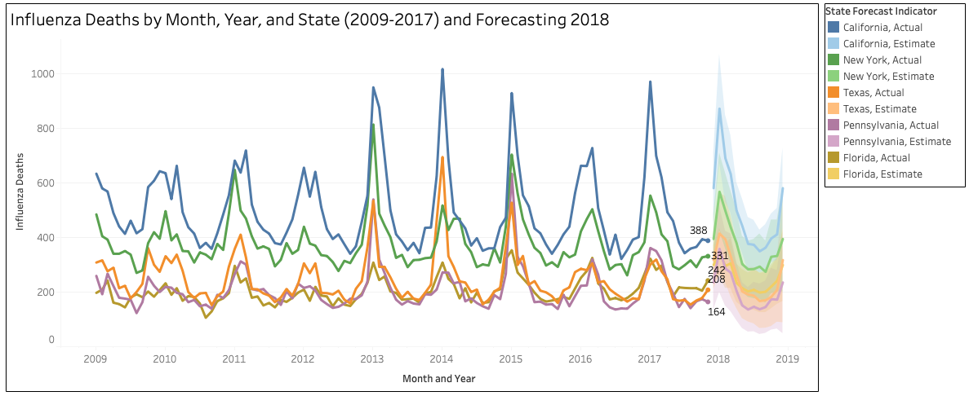
Recommendations
It is recommended that the medical staffing agency send additional nurses, physician assistants, and doctors in the winter season.
Based on the bubble chart, it is recommended that the staffing agency send more nurses, physician assistants, and doctors to California, New York, Texas, Pennsylvania, and Florida during influenza season.
If you look at the forecast from the line chart, you will notice influenza deaths will continue to increase for some states in 2018.
California, New York, Texas, Pennsylvania, and Florida should be prioritized as “high need” for additional medical staffing based on the large population and high number of influenza deaths for individual over the age of 65.
Click icons for storyboard and video

